Slide 1

Self-Healing Networks: The Future of Autonomous Networking
AKSHAY C K (AWH23MCA-2006)
Guide: Muhammad Muhsin k

Slide 2
What is network ?
A network is a system of interconnected devices, nodes, or systems that communicate and share resources with each other
Networks are essential for transmitting data, enabling communication, and providing access to information and resources.

Slide 3
Why traditional network management is insufficient ?
Why traditional network management is insufficient.
Manual intervention leads to delays in resolving issues.
Inability to handle the complexity of modern, dynamic networks.
Lack of real-time monitoring and automated responses.
Increased risk of downtime, human errors, and inefficiencies.

Slide 4
Need for automation and intelligence in modern networks.
Need for automation and intelligence in modern networks.
Modern networks are highly dynamic, requiring quick adaptability.
Manual processes cannot scale to handle large volumes of traffic and devices.
Automation minimizes human error and ensures consistency.
Intelligence via AI/ML enables proactive and predictive decision-making

Slide 5
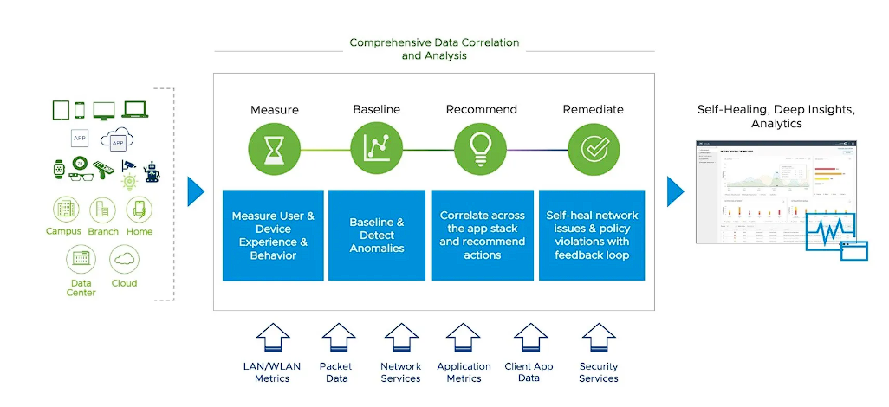
What is a Self-Healing Network ?
A self-healing network is an intelligent, automated system capable of detecting, diagnosing, and resolving network issues without human intervention.
It leverages AI, machine learning, and automation to ensure continuous and reliable network performance.

Slide 6
Key Concept:
Networks that can detect, diagnose, and resolve issues autonomously are the cornerstone of self-healing networks.
These networks operate by continuously monitoring their own performance, identifying anomalies or inefficiencies, and taking immediate corrective actions.
They rely on machine learning models that adapt and improve over time, ensuring evolving resilience to new challenges.
They significantly improve operational efficiency by minimizing the need for human intervention.

Slide 7
Core Principles of Self-Healing Networks
Automation:
Automated workflows enable faster detection and remediation of network issues, reducing response time.
Examples include automated fault isolation, system updates, and configuration changes.
Artificial Intelligence (AI) and Machine Learning (ML) are pivotal in enabling networks to self-heal.
Intelligence through AI and ML:
AI analyzes vast amounts of network data in real-time to identify patterns and anomalies.
ML models learn from past incidents, continuously improving the network's ability to predict and prevent failures.
Enables dynamic decision-making and optimization without human input.

Slide 8
Core Principles of Self-Healing Networks
Proactive Optimization:
Self-healing networks optimize configurations before failures occur.
Predictive analytics and trend analysis help identify potential weak points.
Resilience Against Failures:
Ensures high availability by automatically rerouting traffic or repairing issues.

Slide 9
Architecture of a Self-Healing Network
Analytics Engines:
Key components:
Sensors for Data Collection:
Sensors continuously monitor network components such as routers, switches, and servers.
Collects real-time data on performance metrics, traffic patterns, and potential faults.
Provides the foundational data required for analysis and decision-making
Analytics Engines:
Process the data collected by sensors.
Identify patterns, anomalies, and potential issues using AI/ML algorithms.
Enable real-time insights and decision-making.

Slide 10
Architecture of a Self-Healing Network
Decision-Making Algorithms:
Analyze processed data to determine the best course of action.
Prioritize tasks and automate resolutions.
Ensure minimal impact on network performance during fault resolution.
Execution Layers for Corrective Actions:
Implement the decisions made by algorithms.
Include rerouting traffic, patching software, or isolating faulty components.
Provide feedback to analytics engines for continuous improvement

Slide 11
Mechanisms of Self-Healing Networks
Fault Detection: Monitoring and anomaly identification.
Continuous collection of performance data from network elements.
Sensors monitor traffic flow, device health, and error logs.
Real-time analytics engines detect deviations from normal behaviour.
Example: Identifying packet loss, latency spikes, or bandwidth congestion.
Diagnosis: Identifying root causes.
Using AI models to pinpoint faulty devices, misconfigurations, or external attacks.
Correlating multiple data sources to identify cascading issues.

Slide 12
Mechanisms of Self-Healing Networks
Remediation: Applying corrective measures.
Executing predefined actions like rerouting traffic, resetting devices, or deploying updates.
Testing implemented fixes to ensure effectiveness.
Prevention: Optimizing configurations proactively.
Predictive analysis to mitigate future risks.
Continuous adaptation to dynamic network conditions.

Slide 13
Fault Detection Process
Continuous network monitoring.
Involves real-time data collection from routers, switches, servers, and other network devices.
Use of sensors and logs.
Sensors detect traffic anomalies, error rates, and device malfunctions.
Log analysis helps track historical patterns and deviations.
Identifying patterns and anomalies.
AI/ML algorithms analyse collected data to detect irregularities.
Example: Spotting unusual bandwidth usage indicating a potential DDoS attack.

Slide 14
Technologies Enabling Self-Healing Networks
Artificial Intelligence and Machine Learning.
Software-Defined Networking (SDN):- it changes how networks are designed, operated, and managed by shifting from traditional hardware-based networking to software-based management
Network Function Virtualization (NFV):- virtualizes traditional network services like firewalls, load balancers, and routers by running them as software instead of relying on dedicated hardware devices.
Automation tools (e.g., Ansible, Terraform):- These tools enable faster deployment, simplified management, real-time monitoring, and scaling of network services.

Slide 15
Diagnosis Process
Root Cause Analysis (RCA):
AI-driven RCA analyzes extensive datasets to trace the source of faults.
Machine learning models compare current anomalies to historical data for precise diagnosis.
Identifying Hardware or Software Issues:
Pinpointing failing devices, misconfigured settings, or software bugs.
Using diagnostic tools to assess the health of routers, switches, and servers.

Slide 16
Diagnosis Process
Prioritizing Critical Problems:
AI helps prioritize issues based on their impact on the network.
Critical faults are resolved immediately to minimize disruption.
Tools and Methods:
Use of AI/ML-based analytics engines for data correlation and anomaly detection.
Employing SDN controllers to gather holistic network insights.

Slide 17
Remediation Process
Automated solutions (e.g. Rerouting, patching):
Automated solutions are predefined, programmatically executed actions that resolve network issues without manual intervention. These actions are triggered by detection and diagnosis processes in a self-healing network.
Feedback loop for iterative improvement:
A feedback loop is a mechanism where outcomes of remediation actions are analyzed and used to enhance future performance and decision-making processes in self-healing networks.
Example: Traffic rebalancing in case of congestion.

Slide 18
Applications of Self-Healing Networks
Telecommunications: telecom providers ensure uninterrupted service by detecting and resolving network congestion, equipment failures, and cyber threats in real-time.
IoT: IoT-enabled devices by detecting failures and optimizing performance in real-time.
Data Centers: dynamically reallocating resources, optimizing traffic, and preventing downtime through automated fault resolution.
Enterprise Networks: Large enterprises use self-healing networks to maintain seamless operations by automatically identifying and mitigating security threats, ensuring optimal performance, and reducing manual intervention.

Slide 19
Prevention Process
Optimizing configurations proactively.
Proactively optimizing configurations involves making adjustments and enhancements to the network setup in anticipation of potential problems or inefficiencies, rather than waiting for issues to occur.
Machine learning models predicting future failures.
Machine Learning (ML) models are trained to analyze past data, current network conditions, and usage patterns to identify potential failure points before they occur.

Slide 20
Benefits of Self-Healing Networks
Improved uptime and reliability.
Automated detection and remediation reduce downtime significantly.
Self-healing mechanisms identify and resolve issues before they impact users.
Reduced operational costs.
Self-healing networks reduce operational costs by automating routine tasks, minimizing downtime, and reducing the need for manual interventions.
Automation decreases the dependency on large IT teams, enabling reallocation of resources to strategic initiatives.

Slide 21
Benefits of Self-Healing Networks
Faster fault resolution
Self-healing networks achieve faster fault resolution through automated processes like real-time anomaly detection, root cause analysis using AI, and the application of predefined corrective actions.
Example: If a device becomes unresponsive, the network can automatically isolate it and reroute traffic to ensure uninterrupted service.
Enhanced security through real-time threat mitigation
involves using advanced technologies and methodologies to detect, respond to, and recover from cyber threats autonomously

Slide 22

Thank You

